Slide 1
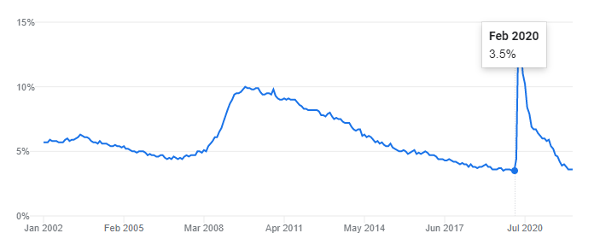
Unemployment Immediately Prior to COVID
Source: US Department of Labor Statistics

Slide 2
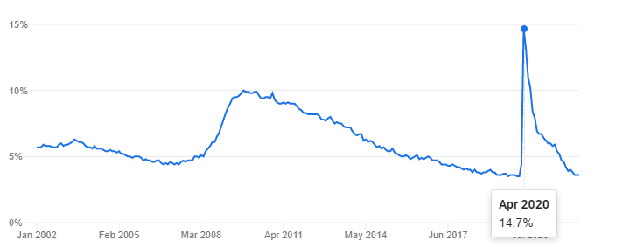
Unemployment During COVID “Panic”
Source: US Department of Labor Statistics

Slide 3
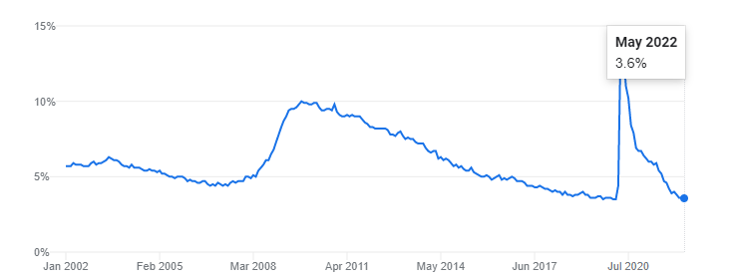
Unemployment Today
Source: US Department of Labor Statistics

Slide 4
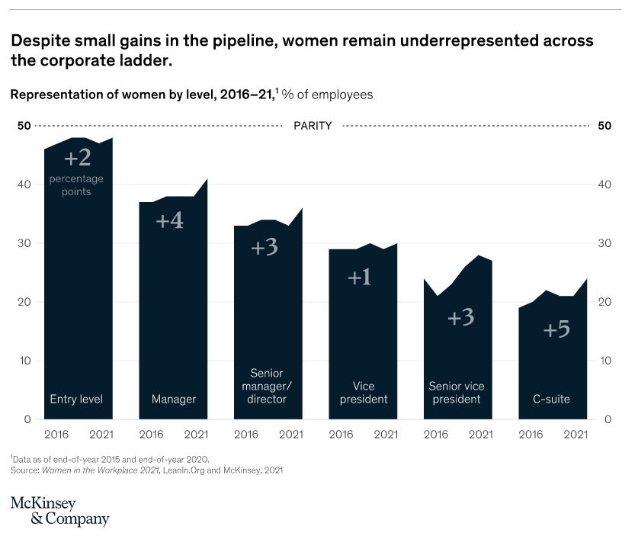

Slide 5
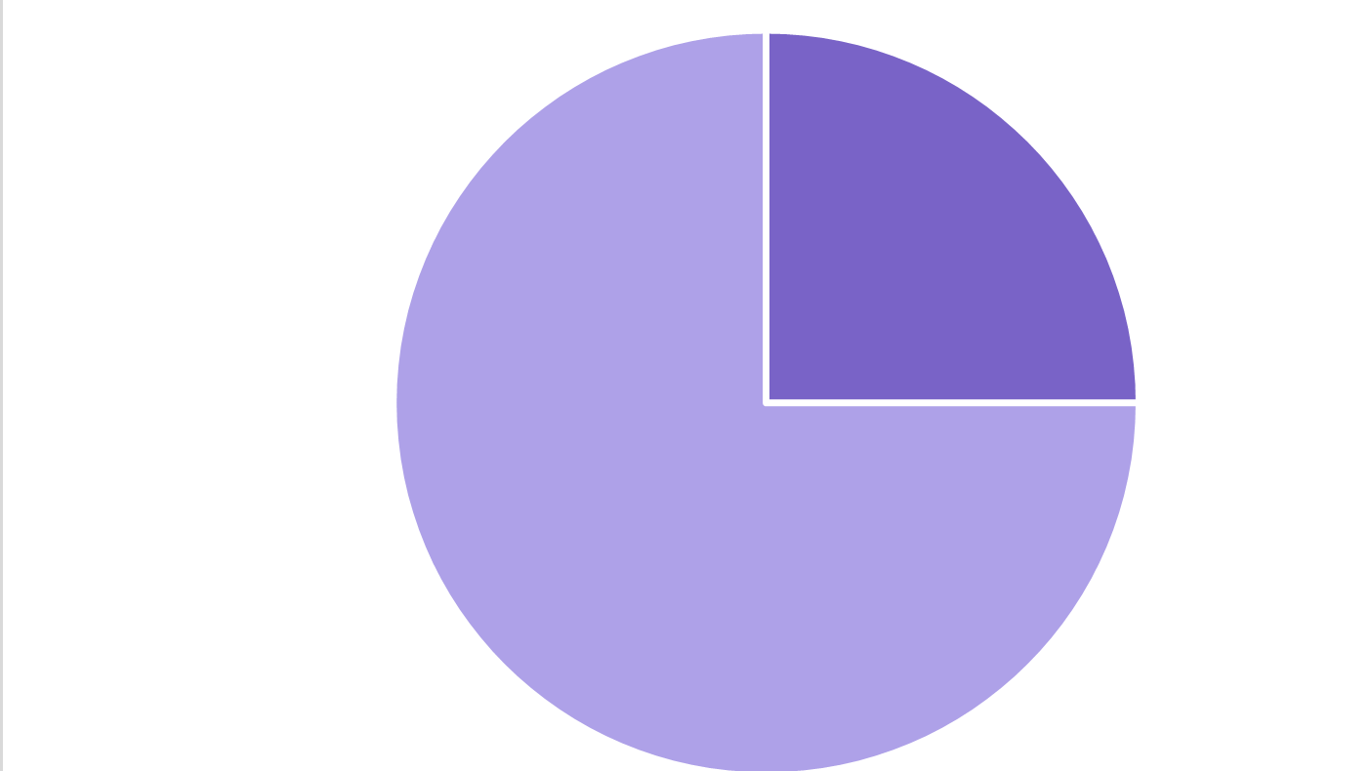
Downshift or Departure by Women
Fall 2020
Source: McKinsey & Company / LeanIn.org - Women in the Workplace (Annual Reports - 2020 and 2021)

Slide 6
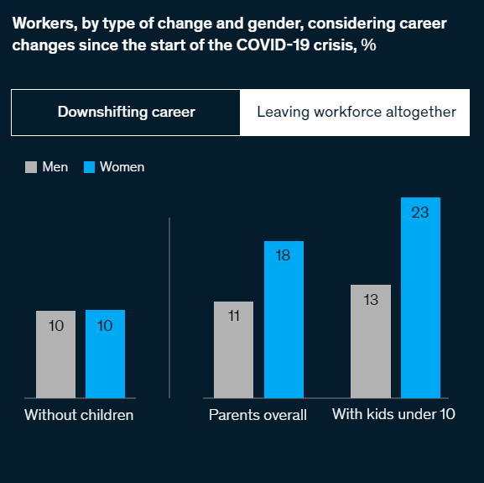

Slide 7
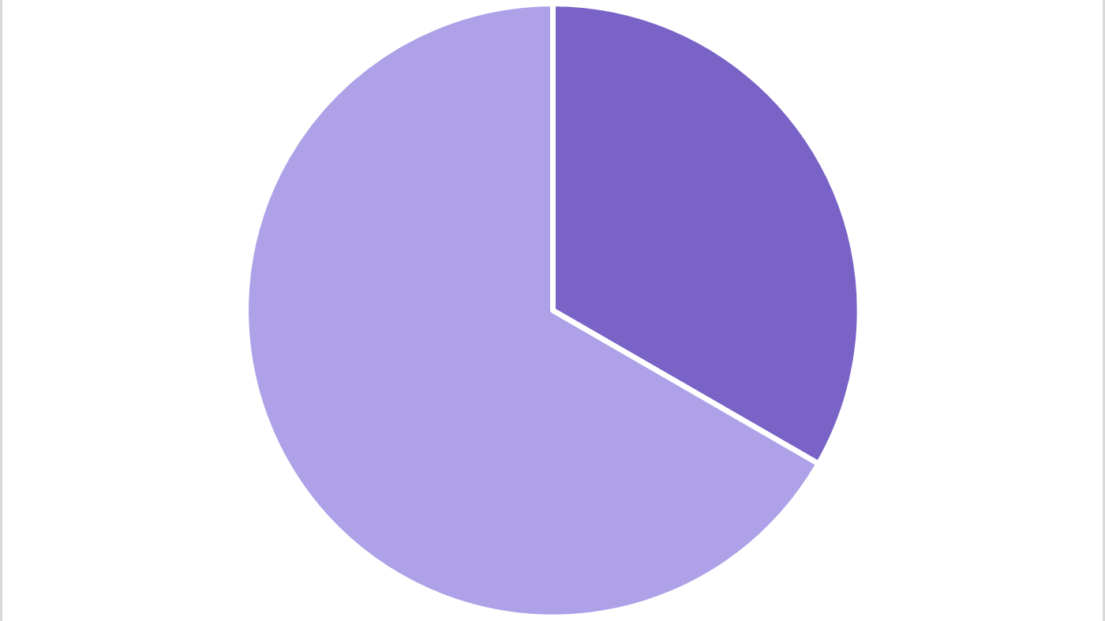
Downshift or Departure by Women
Fall 2021
Source: McKinsey & Company / LeanIn.org - Women in the Workplace (Annual Reports - 2020 and 2021)

Slide 8
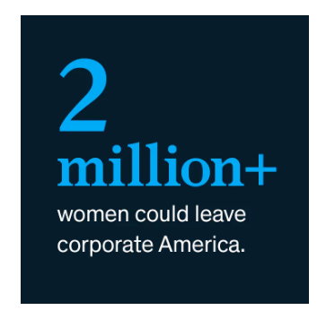

Slide 9
The Great Resignation isn't a mad dash away from the office. It's the culmination of a long march toward freedom. Flexibility is more than choosing the place where you work. It's having freedom to decide your purpose, your people, and your priorities.
Organizational Psychologist Adam Grant October 2021

Slide 10
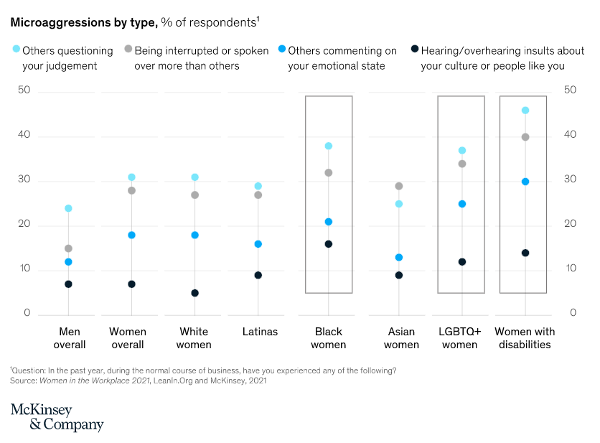

Slide 11
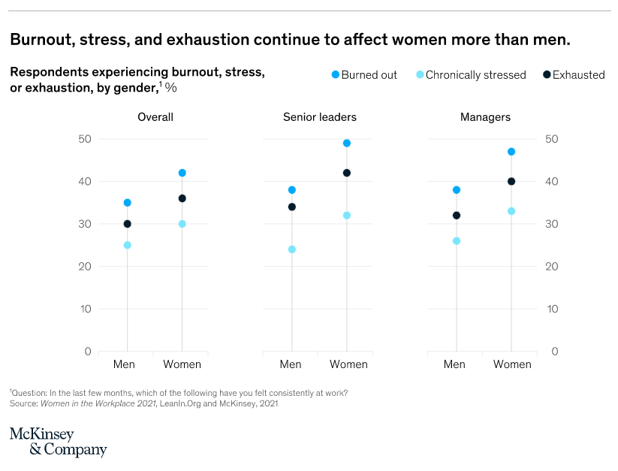

Slide 12
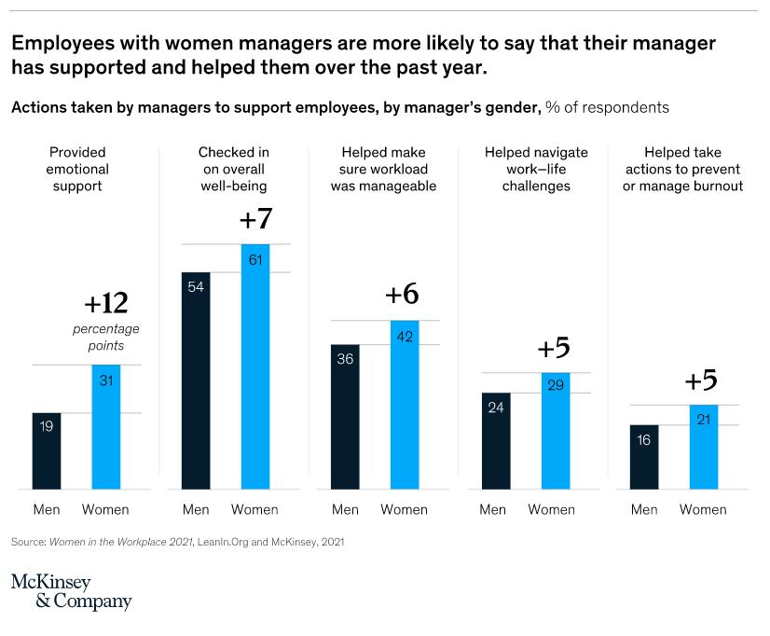

Slide 13




